Slide 1
SQUARE Methodology
Dr Mu Yang
COMP6236 - Software Engineering and Cyber Security

Slide 2
Today
SQUARE Methodology

Slide 3
Learning outcomes
Differentiate among security goals, security requirements
Identify and list security goals
Identify and list security requirements
Prioritize security requirements

Slide 4
SQUARE
Developed by the CERT® Program at SEI, Carnagie Mellon University

Slide 5
SQUARE
Developed by the CERT® Program at SEI, Carnagie Mellon University
Step-wise methodology for eliciting, categorizing and prioritizing security requirements

Slide 6
SQUARE
Developed by the CERT® Program at SEI, Carnagie Mellon University
Step-wise methodology for eliciting, categorizing and prioritizing security requirements
Who is involved?
Stakeholders of the software
Requirements engineers with security expertise

Slide 7



































SQUARE Process
Agree on definitions
Elicit security
Categorize
requirements
requirements
Select elicitation techniques
Identify security goals
Prioritize requirements
Develop
Perform risk
Requirements Inspection
artifacts
assessment

Slide 8
Online Shop
A web shop is going to be set up for music, video, films, call tunes, software and other products for mobile computer equipment like 3G phones.
6 Essential Functionalities
Search product
Buy product
Establish customer account
Set customer information
Log into customer account
Log out from customer account

Slide 9
Step 1 Agree on Definitions
Objective: Agree on definitions between stakeholders and the requirements engineering team
Output: Well-documented set of agreed definitions
confidentiality
The property that information is not made available or disclosed to unauthorized individuals, entities, or processes (i.e., to any unauthorized system entity).
Ensuring that information is available to only those with authorized access.
Restricting access to information via a hierarchy of classes of access.
Other:
[SANS 03a]
[ISO 04]
[JONES 02]

Slide 10
Step 1 Agree on Definitions
Objective: Agree on definitions between stakeholders and the requirements engineering team
Output: Well-documented set of agreed definitions
For each term
Options to select
confidentiality
The property that information is not made available or disclosed to unauthorized individuals, entities, or processes (i.e., to any unauthorized system entity).
Ensuring that information is available to only those with authorized access.
Restricting access to information via a hierarchy of classes of access.
Other:
[SANS 03a]
[ISO 04]
[JONES 02]
Well cited

Slide 11
Step 2: Identify Security Goals
Objective: Stakeholders must formally agree on a set of prioritized security goals
Identify a single business goal
Identify approximately six security goals
Resolve conflicts among security goals
Prioritize security goals
Requirements engineering team must ensure that security goals are generated, not security requirements or recommendations
Output: Single business goal, prioritized security goals

Slide 12
Step 2: Identify Security Goals
Objective: Stakeholders must formally agree on a set of prioritized security goals
Identify a single business goal
Identify approximately six security goals
Resolve conflicts among security goals
Prioritize security goals
Requirements engineering team must ensure that security goals are generated, not security requirements or recommendations
Output: Single business goal, prioritized security goals
Stakeholders’ responsibility

Slide 13
Step 2: Identify Security Goals
Objective: Stakeholders must formally agree on a set of prioritized security goals
Identify a single business goal
Identify approximately six security goals
Resolve conflicts among security goals
Prioritize security goals
Requirements engineering team must ensure that security goals are generated, not security requirements or recommendations
Output: Single business goal, prioritized security goals
Stakeholders’ responsibility
Brainstorm

Slide 14
Step 2: Identify Security Goals
Objective: Stakeholders must formally agree on a set of prioritized security goals
Identify a single business goal
Identify approximately six security goals
Resolve conflicts among security goals
Prioritize security goals
Requirements engineering team must ensure that security goals are generated, not security requirements or recommendations
Output: Single business goal, prioritized security goals
Stakeholders’ responsibility
Brainstorm
RQ Engineers review and provide feedback on…

Slide 15
Step 2: Identify Security Goals
Objective: Stakeholders must formally agree on a set of prioritized security goals
Identify a single business goal
Identify approximately six security goals
Resolve conflicts among security goals
Prioritize security goals
Requirements engineering team must ensure that security goals are generated, not security requirements or recommendations
Output: Single business goal, prioritized security goals
Stakeholders’ responsibility
Brainstorm
RQ Engineers review and provide feedback on…

Slide 16
Step 2: Identify Security Goals
Generate security goals not security requirements not recommendations!!!
Security goal:
The system shall be available for use when needed.

Slide 17
Step 2: Identify Security Goals
Generate security goals not security requirements not recommendations!!!
Requirements – state what must be done
“A continuity of operations plan (COOP) must be in place to assure system availability.”
Recommendations – state a general good idea
“Invest in backup information technology hardware to ensure business continuity.”
Security goal:
The system shall be available for use when needed.

Slide 18
Step 2: Identify Security Goals
Results of Step 2 are very important!
Without overall security goals for the project, it is impossible to identify the priority and relevance of any security requirements that are generated.
The establishment of security goals scopes the rest of the SQUARE process.
10

Slide 19
Step 2: Identify Security Goals
Business Goal
The system allows the client to buy music, video, films, call tunes, software and other products for mobile devices
Security Goals
G-01 The system shall be available for use when needed.
G-02 The integrity, accuracy, and confidentiality of customers' data shall be maintained.

Slide 20
Step3 Develop Artifacts
Objective: Collect a complete set of artifacts of the system
Desirable artifacts to collect
System architecture diagrams
Use case diagrams
Misuse case diagrams
Attack trees
Output: architecture diagrams, use cases, misuse cases, attack trees, templates, forms..

Slide 21
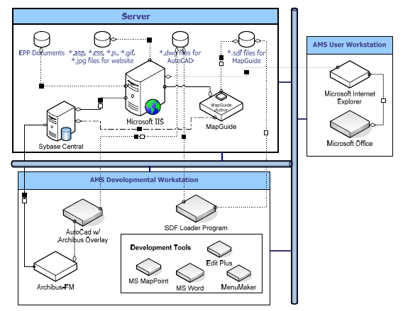
Step 3 Develop Artifacts
System architecture diagram

Slide 22
Step 3: Develop Artifacts
Use case diagram
MWS-3: Establish customer account
MWS-1: Search for product
<<extend>>
MWS-2: Buy product
Customer
<<include>>
<<include>>
MWS-5: Log into customer account
<<include>>
MWS-6: Log out from customer account
MWS-4: Set customer information

Slide 23
Step 3: Develop Artifacts
Threatens
Misuse case diagram
MWS-3: Establish customer account
MSC-1: SQL injection
MWS-1: Search for product
<<extend>>
MWS-2: Buy product
MSC-2: Obtain user name and password
Hacker
Customer
<<include>>
<<include>>
<<include>>
<<include>>
MWS-5: Log into customer account
<<include>>
MWS-6: Log out from customer account
MSC-3: Brute-force attack
MSC-4: Password sniffing
MWS-4: Set customer information

Slide 24
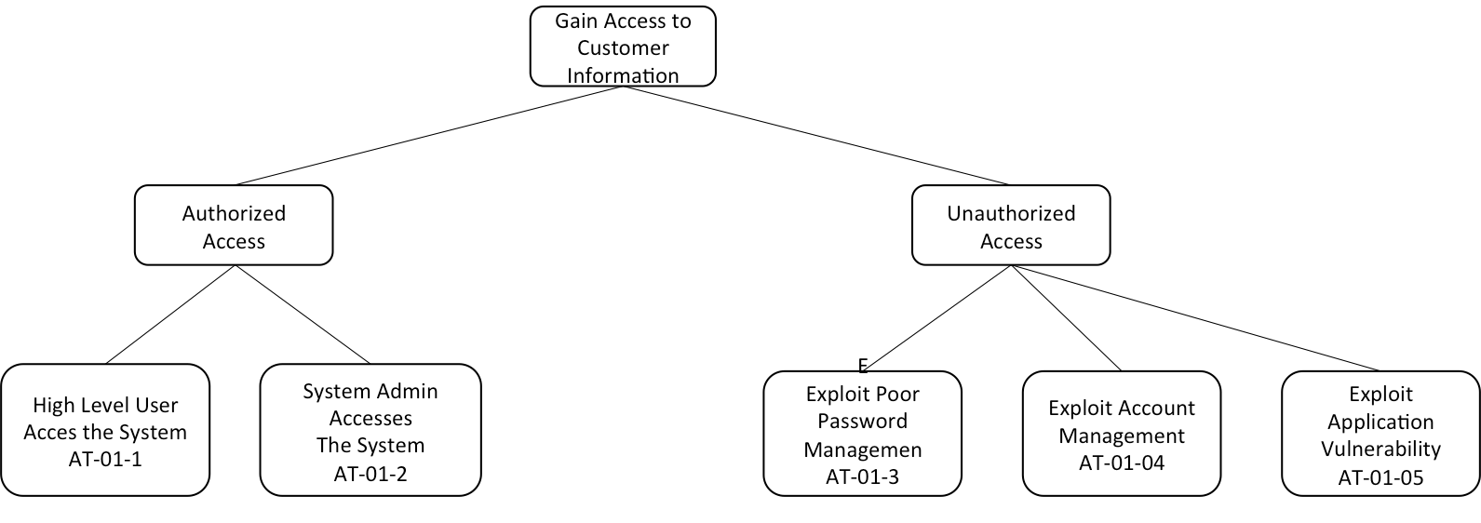
Step 3: Develop Artifacts
Attack tree

Slide 25
Step 3: Develop Artifacts
Mapping between misuse cases and attack trees
Misuse Case Name | Attack Tree
SQL Injection | AT-01-05
Password Sniffing | AT-01-03
Brute Force Attack | AT-01-04

Slide 26
Step 4: Perform Risk Assessment
Objective: The stakeholders and the requirements engineering team must identify
Vulnerabilities and threats that face the system
Likelihood that threats will materialize as real attacks
Potential consequences of an attack
Output: Risk assessment results

Slide 27
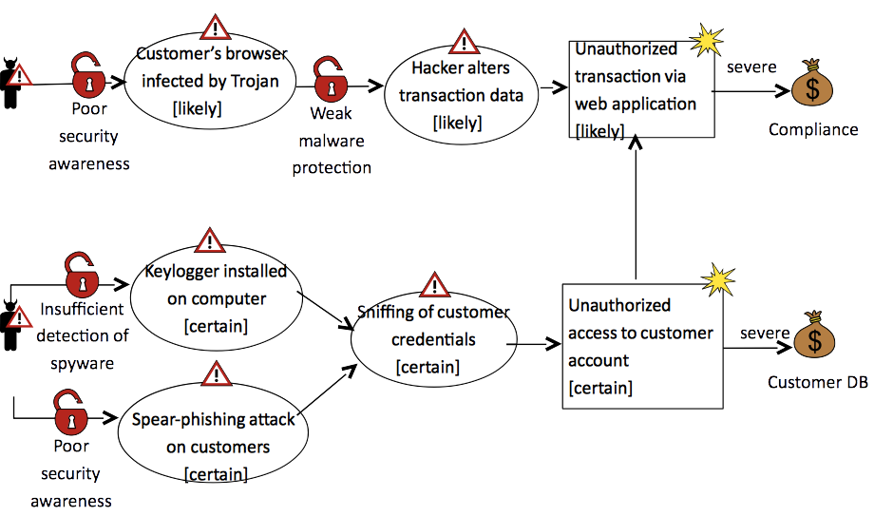
Step 4: Perform Risk Assessment

Slide 28
Step 5: Select Elicitation Technique
Objective: Select an elicitation technique and document the rationale for the choice
Sample of techniques
Structured/Unstructured Interviews
Use/Misuse Cases
Attack Trees
Accelerated Requirements Method (ARM)
Output: Selected elicitation technique + rationale for the choice
20

Slide 29
Step 5: Select Elicitation Technique
Criteria for selection
Adaptability
CASE tool
Client acceptance
Complexity
Graphical output
Implementation duration
Learning curve
Maturity
Scalability

Slide 30
Step 5: Select Elicitation Technique
Criteria for selection
Adaptability
CASE tool
Client acceptance
Complexity
Graphical output
Implementation duration
Learning curve
Maturity
Scalability
to security requirements; diverse environments

Slide 31
Step 5: Select Elicitation Technique
Criteria for selection
Adaptability
CASE tool
Client acceptance
Complexity
Graphical output
Implementation duration
Learning curve
Maturity
Scalability
Computer-aided software engineering (CASE)
Software tool to support

Slide 32
Step 5: Select Elicitation Technique
Criteria for selection
Adaptability
CASE tool
Client acceptance
Complexity
Graphical output
Implementation duration
Learning curve
Maturity
Scalability
e.g., Invasive in a business environment?

Slide 33
Step 5: Select Elicitation Technique
Criteria for selection
Adaptability
CASE tool
Client acceptance
Complexity
Graphical output
Implementation duration
Learning curve
Maturity
Scalability
Easy to understand and execute

Slide 34
Step 5: Select Elicitation Technique
Criteria for selection
Adaptability
CASE tool
Client acceptance
Complexity
Graphical output
Implementation duration
Learning curve
Maturity
Scalability
Visual artifacts

Slide 35
Step 5: Select Elicitation Technique
Criteria for selection
Adaptability
CASE tool
Client acceptance
Complexity
Graphical output
Implementation duration
Learning curve
Maturity
Scalability
The length of time to fully execute

Slide 36
Step 5: Select Elicitation Technique
Criteria for selection
Adaptability
CASE tool
Client acceptance
Complexity
Graphical output
Implementation duration
Learning curve
Maturity
Scalability
The speed that RQ and SH can fully comprehend

Slide 37
Step 5: Select Elicitation Technique
Criteria for selection
Adaptability
CASE tool
Client acceptance
Complexity
Graphical output
Implementation duration
Learning curve
Maturity
Scalability
RQ community

Slide 38
Step 5: Select Elicitation Technique
Criteria for selection
Adaptability
CASE tool
Client acceptance
Complexity
Graphical output
Implementation duration
Learning curve
Maturity
Scalability
Address the RQs of enterprise-level systems

Slide 39
Step 5: Select Elicitation Technique
3 = very good 2 = fair 1 = poor
 | Misuse Cases | ARM
Adaptability | 3 | 2
CASE Tool | 1 | 1
Acceptance | 2 | 3
Complexity | 2 | 2
Graphical Output | 2 | 3
Duration | 2 | 3
Learning Curve | 3 | 1
Maturity | 2 | 1
Scalability | 1 | 2

Slide 40
Step 5: Select Elicitation Technique
Accelerated Requirements Method (ARM)
Most often efficacious in eliciting security requirements

Slide 41
Step 5: Select Elicitation Technique
Accelerated Requirements Method (ARM)
Most often efficacious in eliciting security requirements
Participants asked to contribute seven security requirements in seven minutes
Participants asked to pick three of those requirements as the most important in three minutes

Slide 42
Step 5: Select Elicitation Technique
Accelerated Requirements Method (ARM)
Most often efficacious in eliciting security requirements
Participants asked to contribute seven security requirements in seven minutes
Participants asked to pick three of those requirements as the most important in three minutes
Results posted on a wall and discussed
Identify duplicated and inadequate requirements

Slide 43
Step 6: Elicit Security Requirements
Objective: Identify initial set of security requirements
The requirements engineering team must work with the stakeholders to elicit security requirements for the project (face to face).
They simply execute the technique selected in Step 5
Document the requirements as they are collected
Output: Initial set of security requirements

Slide 44
Step 6: Elicit Security Requirements
Requirements must
be verifiable
not be vague or ambiguous
be quantifiable whenever possible

Slide 45
Step 6: Elicit Security Requirements
Requirements must
be verifiable
not be vague or ambiguous
be quantifiable whenever possible
Bad:“The system shall improve the availability of the existing customer service center”
Good: “The system shall handle at least 300 simultaneous connections to the customer service center”

Slide 46
Step 6: Elicit Security Requirements
R-01 | The system is required to ……
R-02
R-03
R-04
R-05
R-06
 | ………………………………………………………………………………………

Slide 47
Step 7: Categorize Requirements
Objective: Allows requirements engineers and stakeholders to classify requirements, for example, as
Group A : Confidentiality
Group B : Access Control
Group C : Data Integrity
Group D : Authentication

Slide 48
Step 7: Categorize Requirements
Objective: Allows requirements engineers and stakeholders to classify requirements, for example, as
Group A : Confidentiality
Group B : Access Control
Group C : Data Integrity
Group D : Authentication
Detect functional requirements

Slide 49
Step 8: Prioritize Requirements
Objective: Stakeholders choose which requirements to implement
Essential: The produce will be unacceptable if the requirement is absent
Conditional: The requirement enhances security, but the product is acceptable if this requirement is absent
Optional: The requirement is clearly of lower priority than essential and conditional requirements

Slide 50
Step 8: Prioritize Requirements
Objective: Stakeholders choose which requirements to implement
Essential: The produce will be unacceptable if the requirement is absent
Conditional: The requirement enhances security, but the product is acceptable if this requirement is absent
Optional: The requirement is clearly of lower priority than essential and conditional requirements
Use results of risk assessment
Output: Prioritized requirements

Slide 51
Step 9: Requirements Inspection
Objective: Find defects in the requirements
Come to a consensus on the validity of each security requirement

Slide 52
Step 9: Requirements Inspection
Objective: Find defects in the requirements
Come to a consensus on the validity of each security requirement
Verify that each requirement is verifiable and feasible to implement
Verify that each requirement is directly applicable to one or more of the security goals

Slide 53
Step 9: Requirements Inspection
Objective: Find defects in the requirements
Come to a consensus on the validity of each security requirement
Verify that each requirement is verifiable and feasible to implement
Verify that each requirement is directly applicable to one or more of the security goals
Produce final requirements document
Output: Final list of prioritized requirements

Slide 54
Summary
Identify security requirements is essential to avoid security bugs and vulnerabilities and reduce cost of the software development
A security goal is a security concern for an asset
A security requirement is a constraint on a software functionality that operationalize a security goal
SQUARE is a 9-steps methodology to identify, categorize, and prioritize security requirements

Slide 55
Reading Material
Julia H. Allen, Sean Barnum, Robert J. Ellison, Gary McGraw, Nancy R. Mead. Software Security Engineering – A Guide for Project Managers. Chapter 3.
BSI content on requirements engineering
https://buildsecurityin.us-cert.gov/
SQUARE Technical Report – SEI website http://resources.sei.cmu.edu/asset_files/technicalreport/2005_005_001_14594.pdf
SQUARE Case Study reports – SEI website www.sei.cmu.edu/publications/documents/04.reports/04tn045.html www.sei.cmu.edu/publications/documents/05.reports/05sr005.html www.sei.cmu.edu/publications/documents/06.reports/06sr003.html

